Slide 1
Process Evaluation
Process evaluation is an outside-in approach which starts with a broader problem and then drills down to smaller sections of a large value chain.
High
Potential Candidates for Intelligent Automation
Likely Candidates for RPA
At this stage we discuss with C-suite or senior management to understand the pain points and potential process owners are identified. Aligning with stakeholders on process transformation lifecycle. If required, POCs are developed and demonstrated to prove the value in organization.
Socialize
At this stage we participate in detailed walk-through of the potential process by setting up process discovery sessions with the process owners.
Current state process flow is developed.
Collected additional information on processes and collated all relevant process meta data in the form of process repository for evaluation.
Level of Value
Do Not Automate
It depends
Prospecting
Reviewed data and information collected on each process at an activity level and validated the same with process owners.
Measured results are consolidated, quantified and compared with industry benchmarks if applicable.
Or in case of an automation process, amenability for each process is determined using an assessment framework. Please feel free to discuss on this.
Low
High
Low
Validation
Level of Complexity
One possibility of this step is a heat map in above format. Although this is specific to RPA (automation), the final outcome of this overall stage is identification of bottlenecks in a higher level process or identification of processes for automation.
We prioritize processes based on ‘Impact on organization’ and ‘Ease of implementation’
Selected processes are presented to management with potential FTE benefits and complexity levels for implementation
Prioritize & Present
At this stage we validate the assumptions, benefits are calculated and roadmap is presented before a sign-off from business to implement.
Roadmap & Sign-off

Slide 2
Transformation
By the end of process evaluation, a large process in purview is split into smaller sub-processes for process transformation. These sub-processes are clubbed together, based on pre-defined criteria, for wave wise implementation. For instance, if the process is R2R, then journal entry posting can be a sub-process to be transformed.
We connect with process SMEs (working with process owners) and align on the objective of the transformation. This is a kick-off meeting post which the business stake holders and transformation team work closely until completion.
Stakeholder connect
Example :
To set the context, a conglomerate had 39 ERPs entries from which were consolidated for posting on monthly basis. The entire process required multiple days of effort of more than 4 teams every month. Different teams handled different ERPs.
There was an absence of structure for revisiting invalid data.
By time the process transformation was complete, 60 validations were implemented (compared to original 10). Exception report structure for 3 major ERPs were defined. As automation was implemented on the designed process, processing time dropped from days to minutes. Correspondence between teams rendered needless.
This was one of the sub-processes defined in the roadmap for transformation of a broader process.
Regular discussion with stakeholders are held and they are encouraged to suggest on the process : key challenges, implementation scenarios and risks are listed. Minor changes to timeline can be expected at this stage.
Detailed updated design steps are documented at this stage based on the details and measurements collected in the process. This is where process re-engineering begins in essence.
Design
If this is a automation related process, technology teams enters at this stage to develop a bot based on the above design. If its not an IT processes, the change management team comes into picture to design new SOPs and documents, setup workshops and training sessions to implement the change. The key here is to transition as smoothly as possible : keeping the rollback alive.
Implement
At this stage, the updated process design is kicked-off and monitored closely until time as designated in the roadmap during evaluation. Metrics are updated, actual cost-benefit is forecasted and compared with estimated.
These metrics and comparison helps in the next transformation.
Set-live
& monitor

Slide 3
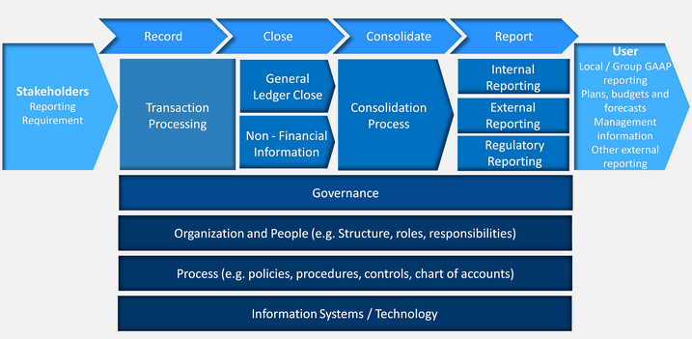
Reporting
Here is my understanding about reporting from an opportunity perspective.
Challenges to Reporting
Record to Report Process Overview
Master Data Inaccuracies: Without a robust master data management implementation, inaccuracies can be encountered during analysis and reporting.
General Ledger : Inefficiencies in upstream data is the cause of this mismatches during consolidation.
Complex Reporting and Compliance Standards : Changes to already complex reporting standards can be difficult to handle. E.g. IRFS.
Best practices & solutions
Automation: This can be extremely effective and low risk option for reconciliation.
Standardization: Standardizing naming convention, automating approval workflows to ensure quality upstream data.
Enforce month end closing : However, this might not always be feasible.
I have worked on assignments, addressing some of such reporting challenges listed above through the best practices mentioned.
For example, in one of the processes, top side entry was made by executives post closing date. A team was setup for monthly reconciliation and validation between ledgers leading to judgement driven steps and human errors.
When the process transformation team stepped in, they connected with stakeholders to identify the issue. This process was redesigned with objective steps to pave way for automation. All the manual effort thereon was discontinued leading to quality enhancement and cost reduction.

Slide 4
Cost
Cost analysis of a firm starts with a problem statement and it is worked upon in an outward-in approach wherein the financial statements are viewed to identify the source of cost. To identify the source of high cost, individual components of above SG&A, COGS and revenue are reviewed and compared with the industry benchmark.
To depict the categories of costs applying to a firm, I have added the below levers utilized in Cost transformation.
----Levers to address cost base----
These are the levers which are generally utilized to address the cost base. Technology implementation comes into picture at one point or the other, in my experience with cost transformation projects. It could be to automate processes, develop a visualizations to gauge organization data, consolidate product information, etc.
Business Process Management
Service Delivery Model
Standardizing, re-engineering and automating end-to-end processes (e.g., order-to-cash, procure-to-pay) across BUs and geographies.
Optimizing the work is performed vis-à-vis the number of resources and at what cost.
I have worked on the Business Process Management and Demand Management related assignments. These involved automation design and implementation, change management. Automation implementation involved RPA for processes like PR-PO, I2C and O2C. Whereas change management was performed alongside a master data management implementation.
Organization Design
External Spend & Demand Management
Defining required functional capabilities, roles & responsibilities, reducing layers and increasing spans of control
Optimizing level of effort by standardizing master data; applying category- specific insights to manage each major spend category

